Slide 1
Pos-Estimation of The Socket of An Electric Car Depending on rgb- Camera
A presentation in:
Advanced Control Methods course
Presented by:
Oussama Alyounes
24.5.2022
Notes:
Hello! We are team 62 or “Smarties”.

Slide 2
Contents
Introduction and overview of the problem.
Algorithm 1: Perspective-n-Points (PnP)
2.1. Mathematical brief.
2.2. Experimental Results.
Algorithm 2: Triangulation
3.1. Mathematical brief.
3.2. Experimental Results.
Comparison of the two Algorithms.
Conclusion and Future Work.

Slide 3
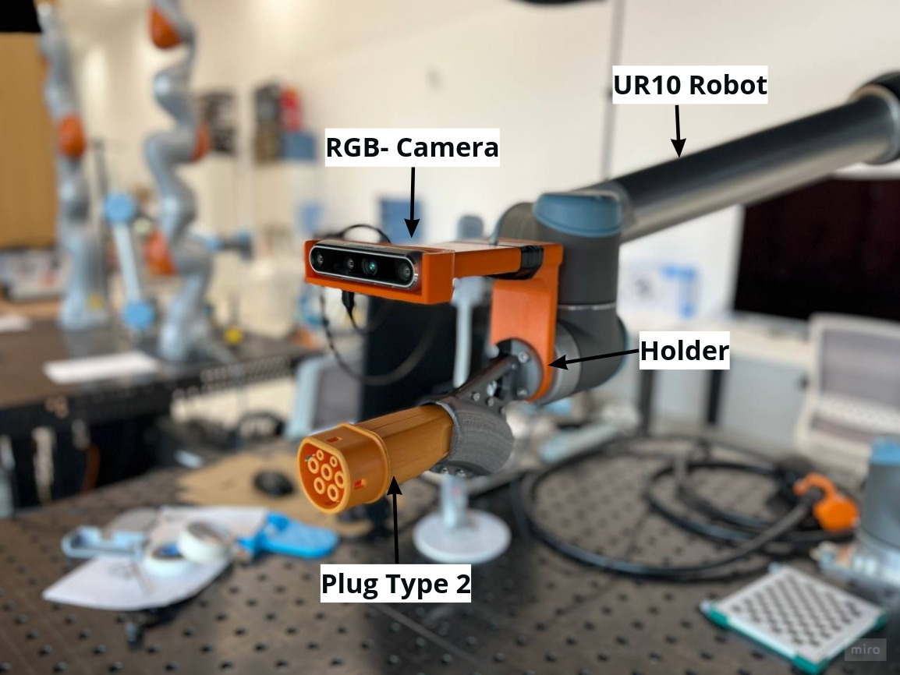
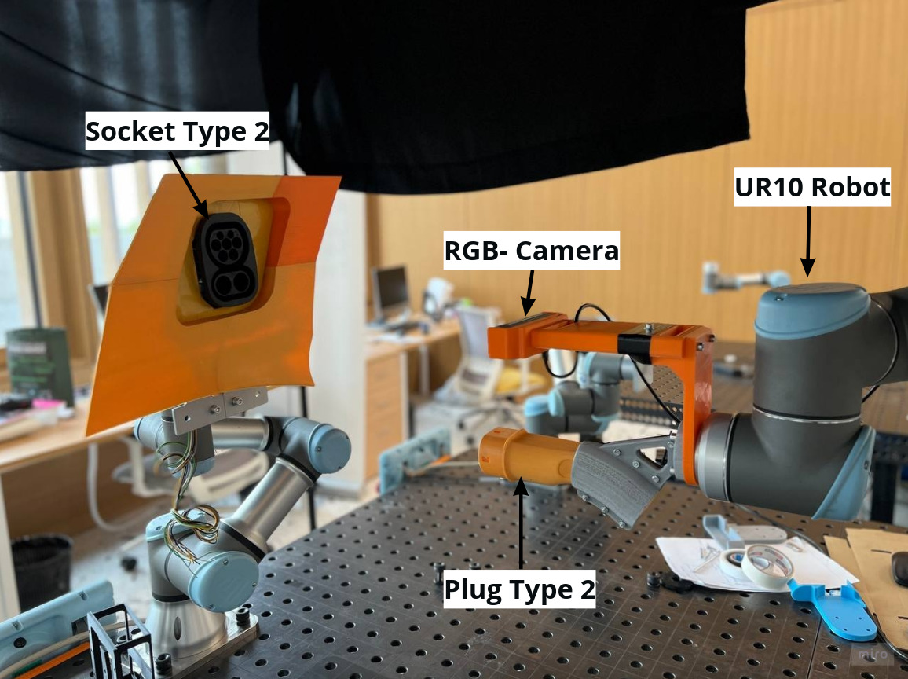
Introduction and overview of the problem
Our main task is to design an autonomous charger for an electric car.
Fig .1 The charging plug module
Fig .2 The Setup of the Experiment

Slide 4
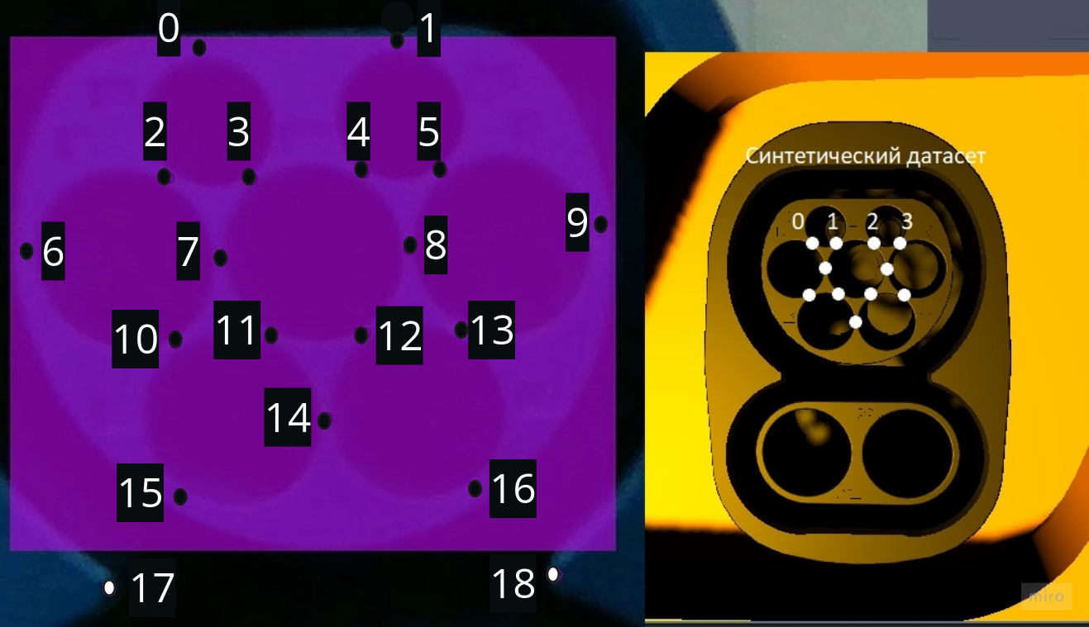
Introduction and overview of the problem
What is done till now is the detection of the 19 keypoints using CNN.
The task now is use these points to get the Transformation between the socket and the robot base.
Fig. 1 The Socket of the electric car with the detected keypoints by CNN

Slide 5
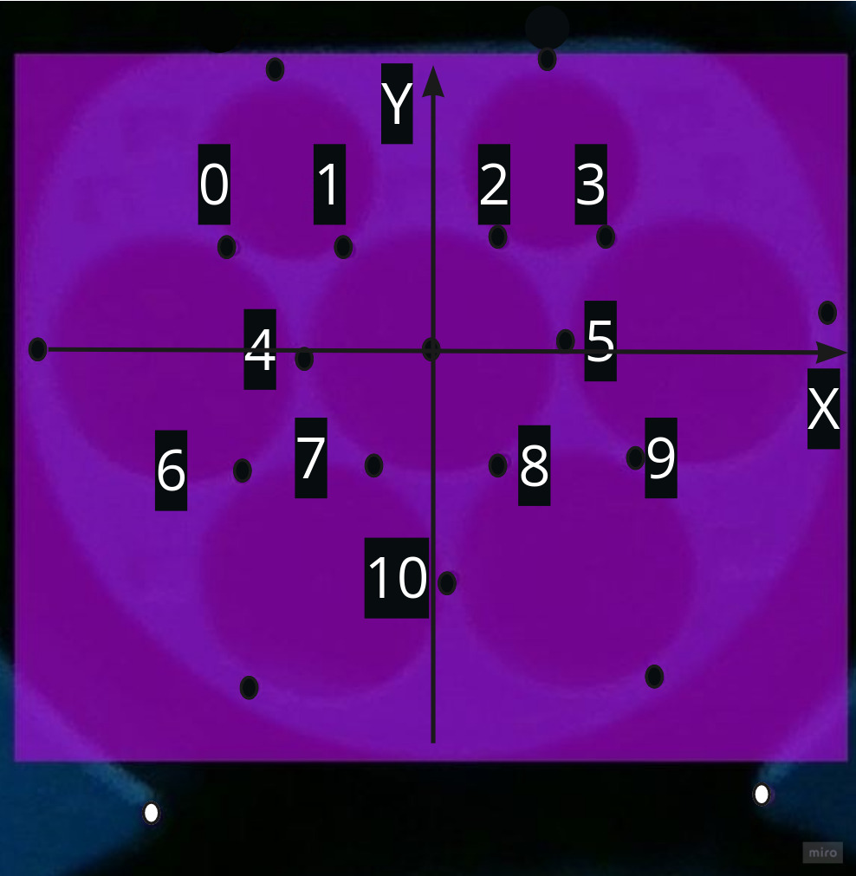
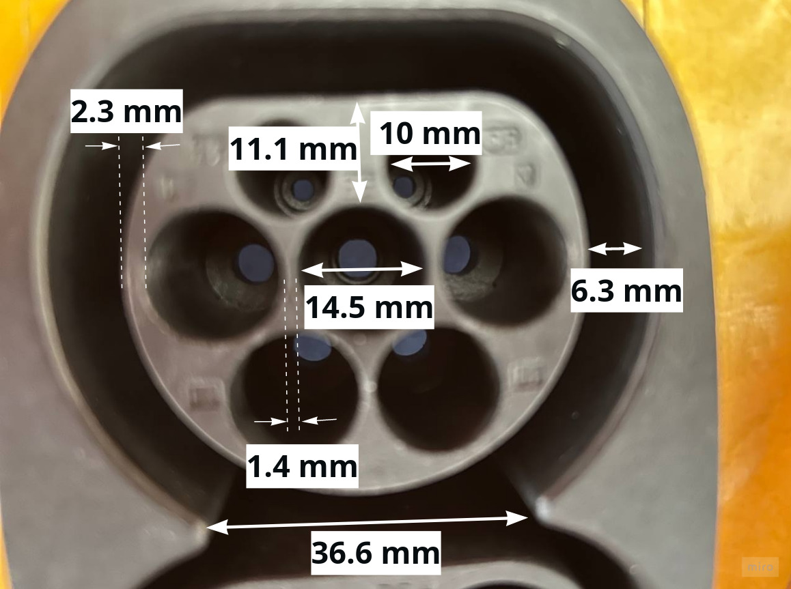
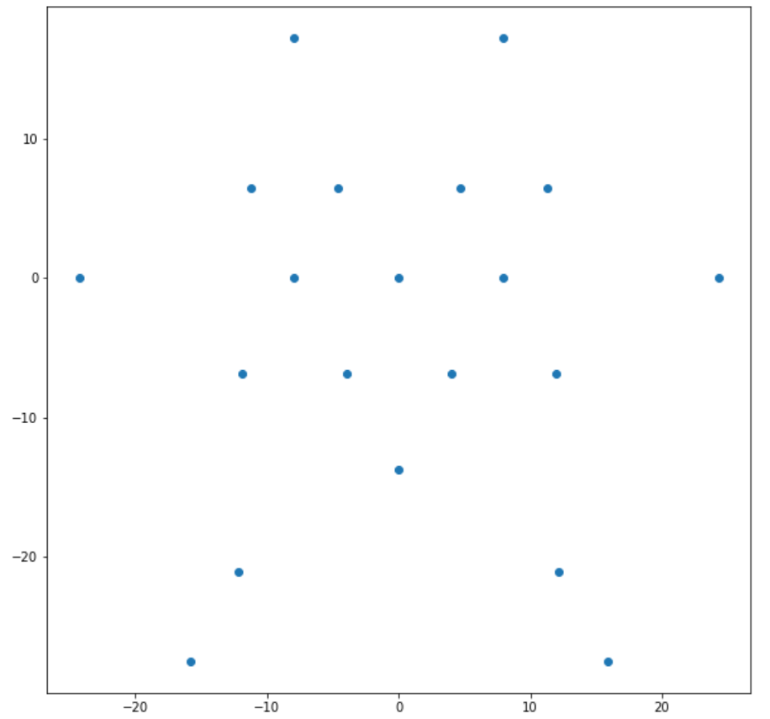
2. Perspective-n-Points (PnP)
2.1. Mathematical brief
Assumption: by our camera we observe at least 4 points, which we know their positions in the world coordinates system.
Task: get the position and orientation of the camera in the world coordinate system.
Fig. 1 The socket with the needed measurements
Fig. 2 The keypoints representation in the groundtruth coordinates
Fig. 3 The keypoints representation using python

Slide 6
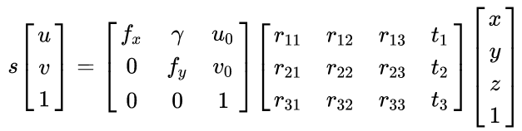
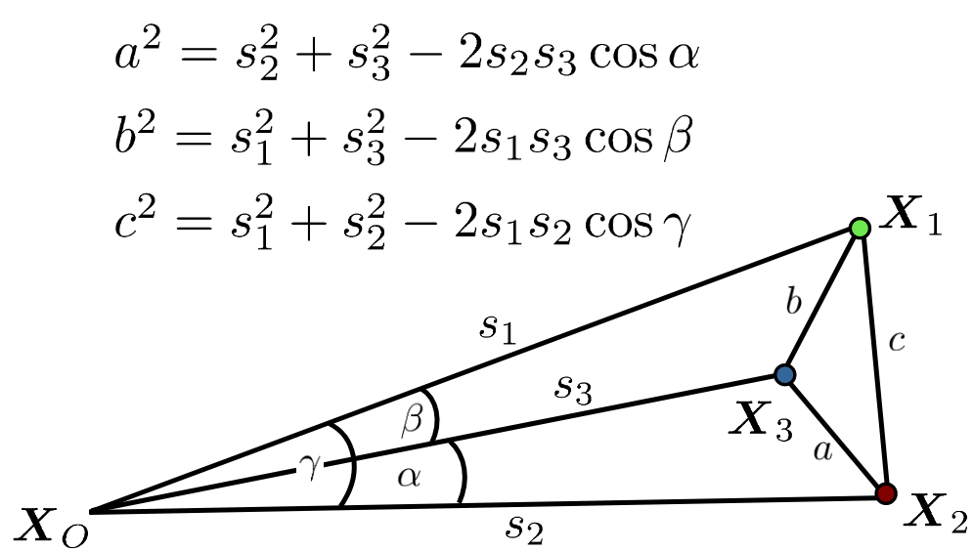

2. Perspective-n-Points (PnP)
2.1. Mathematical brief
Assumption: by our camera we observe at least 4 points, which we know their positions in the world coordinates system.
Task: get the position and orientation of the camera in the world coordinate system.
To do that we need only one image.
Where are constants written with respect to
Fig. 1 The required data for solving PnP problem
[1] Lepetit, V., Moreno-Noguer, F. and Fua, P., 2009. Epnp: An accurate o (n) solution to the pnp problem. International journal of computer vision, 81(2), pp.155-166.

Slide 7
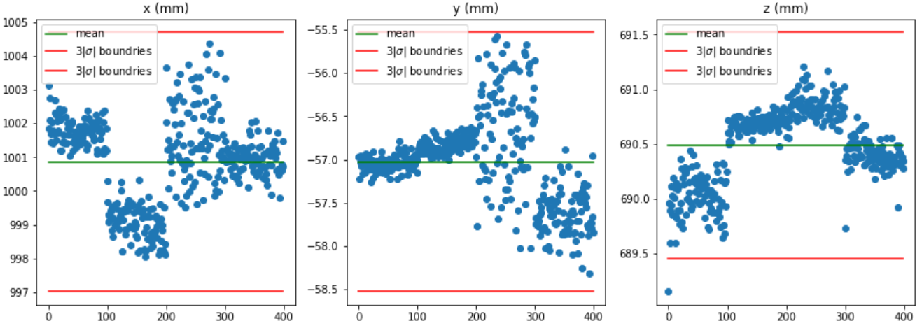

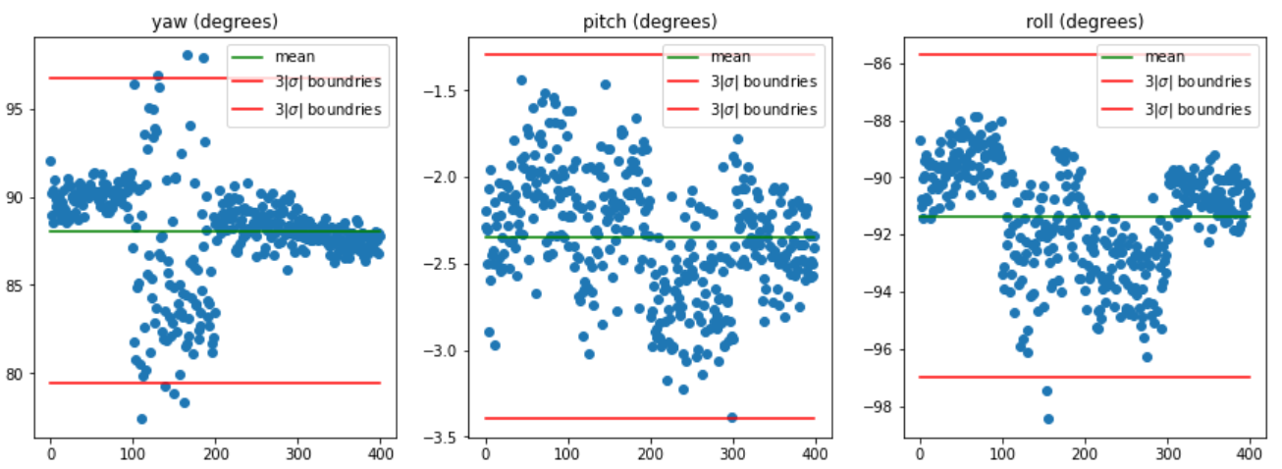
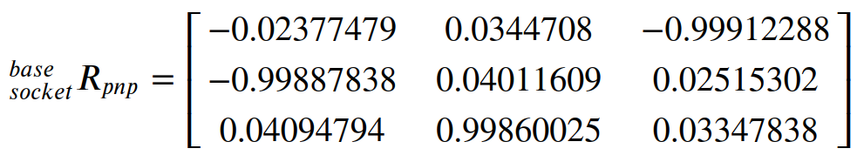
2. Perspective-n-Points (PnP)
2.2. Experimental Results
Fig. 1 Distribution of the position of the camera for each image
Fig. 2 Distribution of the orientation of the camera for each image

Slide 8
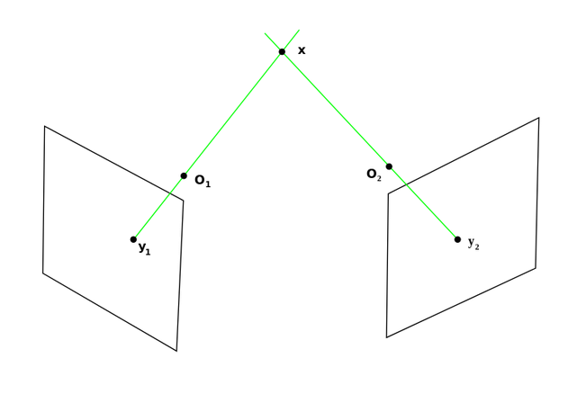
3. Triangulation
3.1. Mathematical brief
Assumption: by our camera we observe keypoints by 2 different images.
Task: get the position and orientation of the camera in the world coordinate system.
Fig. 1 Intersection of two vectors from 2 different images
[1] Hartley, R.I. and Sturm, P., 1997. Triangulation. Computer vision and image understanding, 68(2), pp.146-157.

Slide 9
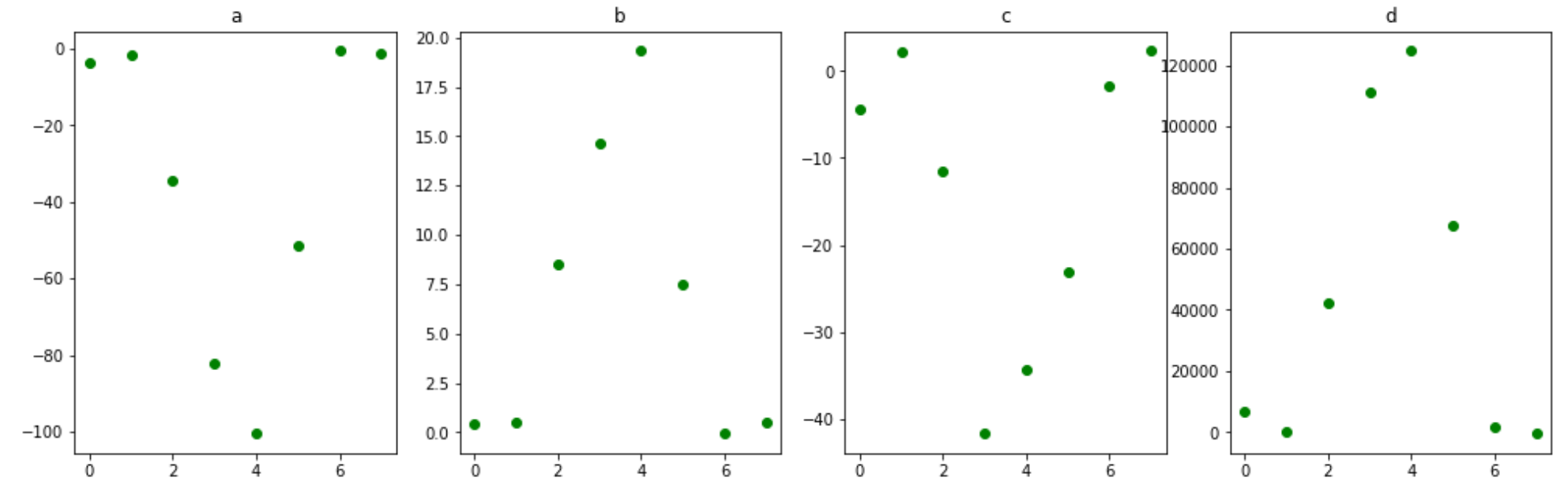

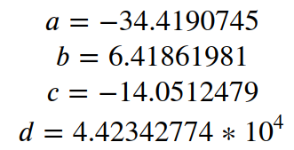
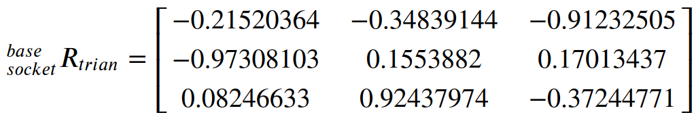
3. Triangulation
3.2. Experimental Results
Using the coordinates of 3 keypoints we can build the plane of the socket.
Fig. 1 Fluctuation of the plane coefficients

Slide 10
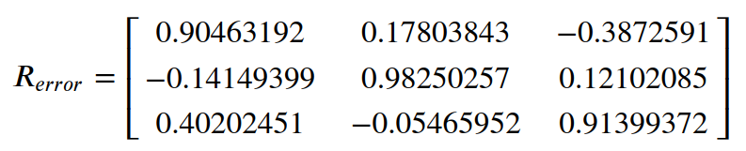



4. Comparison of the two Algorithms

Slide 11
5. Conclusion and Future Work
In the present work, we introduced a comparison on 2 algorithms for pos-estimation. PnP and Triangulation. Pnp requires some measurements and assumption of a virtual coordinate systems, while Triangulation requires some post processing. Pnp depends on 1 image only but Triangulation relies on a pair of images.
In the future work, we aim to apply PnP-RANSAC, and try to include the distortion coefficient of the camera in the Triangulation method. Moreover, we want to verify the precision of the CNN in detecting the keypoints.

Slide 12
References
[1] Lepetit, V., Moreno-Noguer, F. and Fua, P., 2009. Epnp: An accurate o (n) solution to the pnp problem. International journal of computer vision, 81(2), pp.155-166.
[2] Hartley, R.I. and Sturm, P., 1997. Triangulation. Computer vision and image understanding, 68(2), pp.146-157.
[3] Fabbri, R., Kimia, B.B. and Giblin, P.J., 2012, October. Camera pose estimation using first-order curve differential geometry. In European Conference on Computer Vision (pp. 231-244). Springer, Berlin, Heidelberg.

Slide 13

Thank you!
Notes:
Let’s imagine you go to grocery store

